Slide 1
MCF: Culinary Arts
Matthias, Jillian, Shunki, Khat

Slide 2

QR code to score card
https://claude.ai/public/artifacts/a57bf522-83af-4954-8c4a-a9355d38b61d

Slide 3
1
2
3
4
TABLE OF CONTENTS
Introduction
Product
Process
Q & A

Slide 4
01
Introduction

Slide 5
Our Team
Matthias
  Continuous update of the Culinary Arts scorecard based on given feedback across multiple iterations
Jillian
  Created the user testing procedure document and prompts that went out to each user tester, consolidated data into a spreadsheet to gather demographic information
Shunki
  Conducted statistical analysis of user testing data and gathered feedback to report back on to update the Culinary Arts scorecard
Khat
  Analyzed user testing data to conduct SWOT analysis, created user testing data survey, and facilitation/delegation of tasks

Slide 6
02
Product

Slide 7
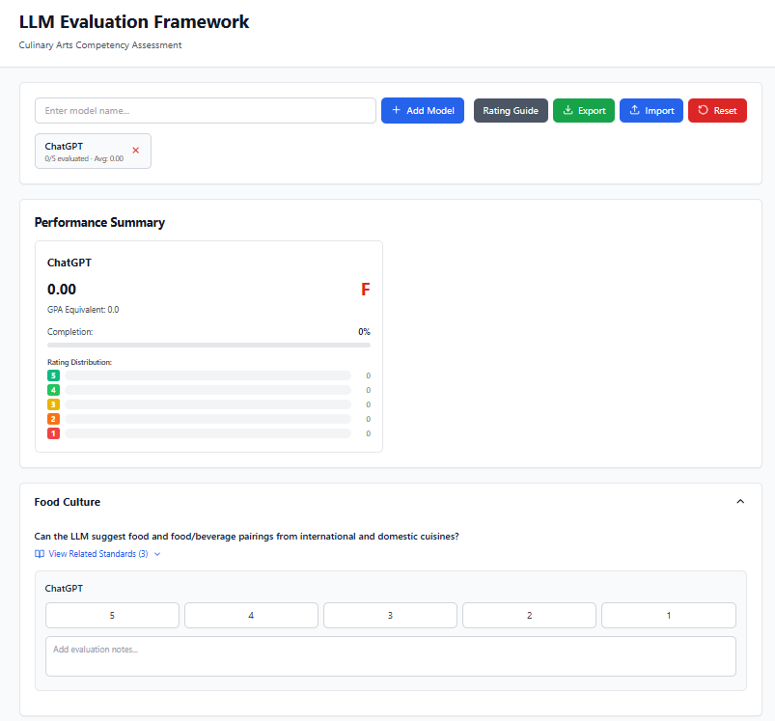
Alpha Version
Model Selection
5-Point Scale
Evaluation
Notes:
Our first round of test users were mostly people we had access to who we knew had some prior experience related to culinary arts, whether personal or professional. Most of our initial user testers were current students (11) or working (5) and most users did not have teaching experience (13).

Slide 8
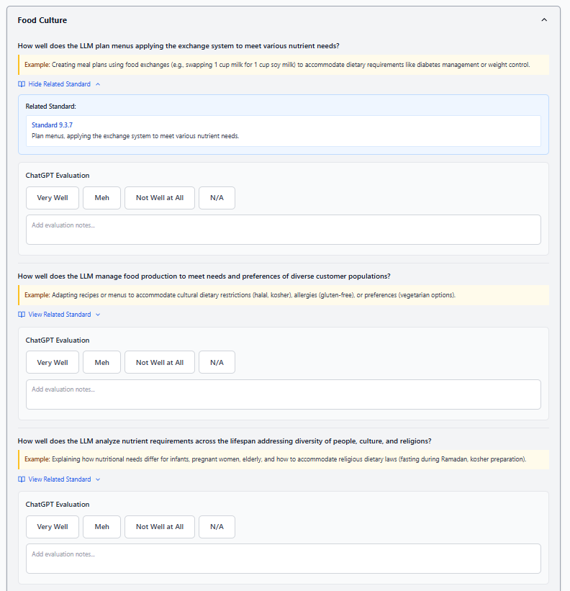
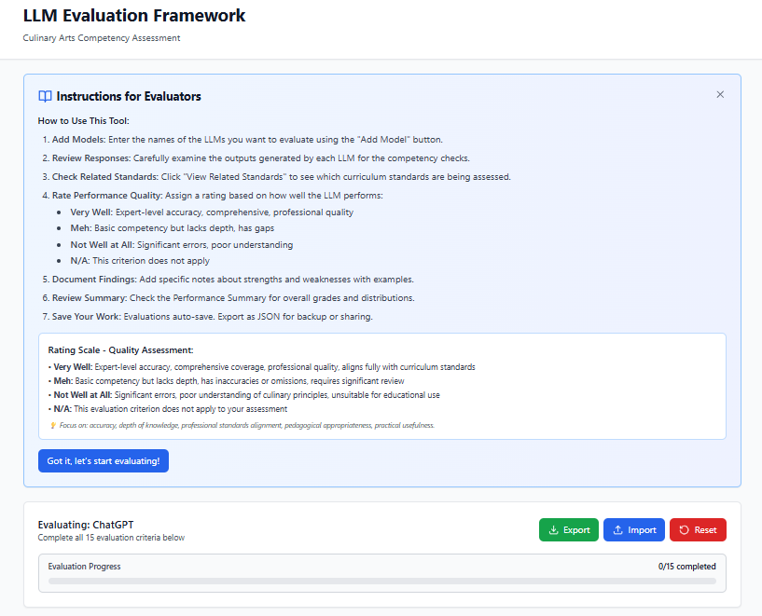
Version 1
Instructions
3-Point Verbal Scale
Examples
Higher Contrast
Notes:
Our first round of test users were mostly people we had access to who we knew had some prior experience related to culinary arts, whether personal or professional. Most of our initial user testers were current students (11) or working (5) and most users did not have teaching experience (13).

Slide 9
Iteration One Feedback: Quantitative
0.8
#
0.75
True (1) or False (0): I feel like this score-card truly captures how I felt about the generated lesson plan.
How would you describe the usability of this scorecard for regular classroom use?
8. Somewhat cumbersome but manageable
6. Reasonably user-friendly
3. Very intuitive and efficient
1. Too complex for practical use
0. Streamlined and easy to use quickly
True (1) or False (0) : I find this score-card easy enough to understand with my current teaching experience in culinary arts.

Slide 10
Iteration One Feedback: Qualitative
“I think there should be significant improvement in the wording of the scorecard questions, as many were unclear, did not make sense, or confused me. If I were to use this for teaching a class and grading the lesson plan, this is far too complex to read through quickly and to score my lesson. The general idea is good, but the work on the questions should be improved. For the prompt that was given to us to use with AI I think clarifying specifics such as asking AI for a recipe since that was not mentioned in the prompt but on the scorecard it was asked about.”

Slide 11
Iteration One Feedback: Qualitative
“I would continue [the scorecard after 1-2 uses] it because it clearly outlines professional culinary standards and expectations. However, it may feel somewhat lengthy for frequent use and could benefit from a streamlined version for quick evaluations.”

Slide 12
Test Users saw potential in our scorecard design, overall finding the scorecard to be aligned with the goal of assessing a lesson plan. However easy the scorecard was to understand, it was not described as practical for typical use.
STREAMLINE FOCUS: scorecard language updates, scorecard scale updates, aesthetic updates

Slide 13
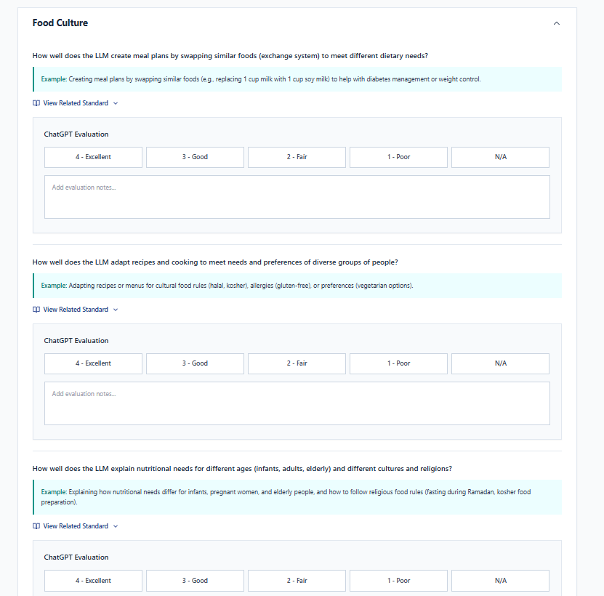
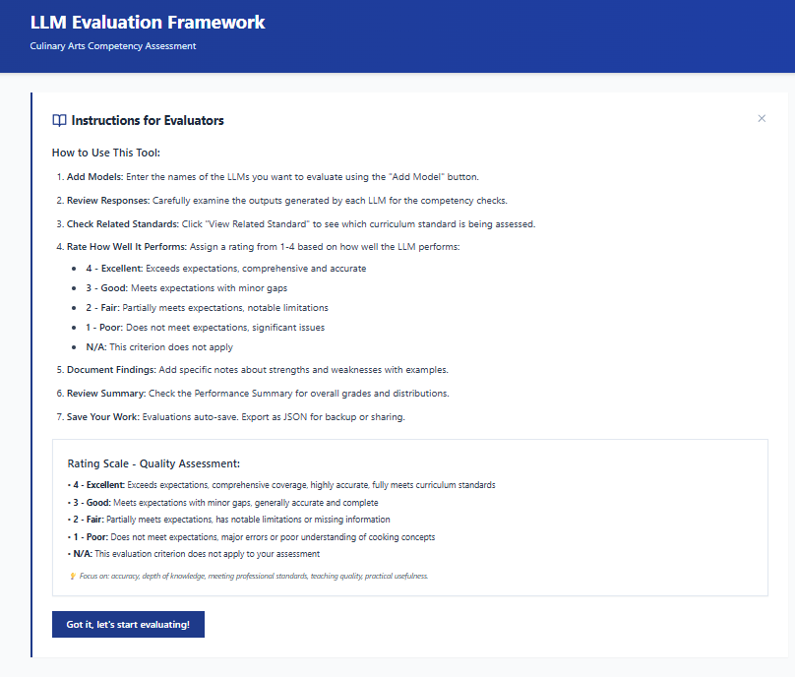
Version 2
Accessible Language
Expandable Cards
Visual Overhaul
4-Point Scale; Clear Wording
Notes:
Our first round of test users were mostly people we had access to who we knew had some prior experience related to culinary arts, whether personal or professional. Most of our initial user testers were current students (11) or working (5) and most users did not have teaching experience (13).

Slide 14
Iteration Two Feedback: Quantitative
0.35
#
1.0
True (1) or False (0): I feel like this score-card truly captures how I felt about the generated lesson plan.
How would you describe the usability of this scorecard for regular classroom use?
8. Somewhat cumbersome but manageable
7. Reasonably user-friendly
3. Very intuitive and efficient
1. Streamlined and easy to use quickly
1. Too complex for practical use
True (1) or False (0):I find this score-card easy enough to understand with my current teaching experience in culinary arts
Notes:
Possible drop in first bullet because mor familiar with ins and out of lesson plans

Slide 15
Iteration Two Feedback: Qualitative
“The new layout is visually very clean, and I appreciate the drop-down menus linking directly to the standards. However, it did not capture my main frustration with the AI: that the content was pedagogically sound but too vague to teach from without further research. The scorecard evaluated the presence of safety and nutrition concepts, but not whether the AI provided the actual instructional material for me to use.”
“I think it is very helpful to focus on specific areas when creating a lesson plan for the culinary arts. It was broad-based, yet specific. It could be used as a template, but if using with an LLM, the prompt would need to include all the details/data/metrics that will be "graded" on the scorecard, so the LLM knows that as it creates the lesson plan”

Slide 16
Test Users rated the scorecard as more intuitive than our previous iteration, though they noted a misalignment between what the scorecard was assessing and what the LLM was generating.
STREAMLINE FOCUS: Aesthetic polishing, scorecard language & scale improvements, workshopping the prompt
Notes:
This is likely also partly a reason in the drop in if the scorecard captures how truly feel about the lesson.

Slide 17
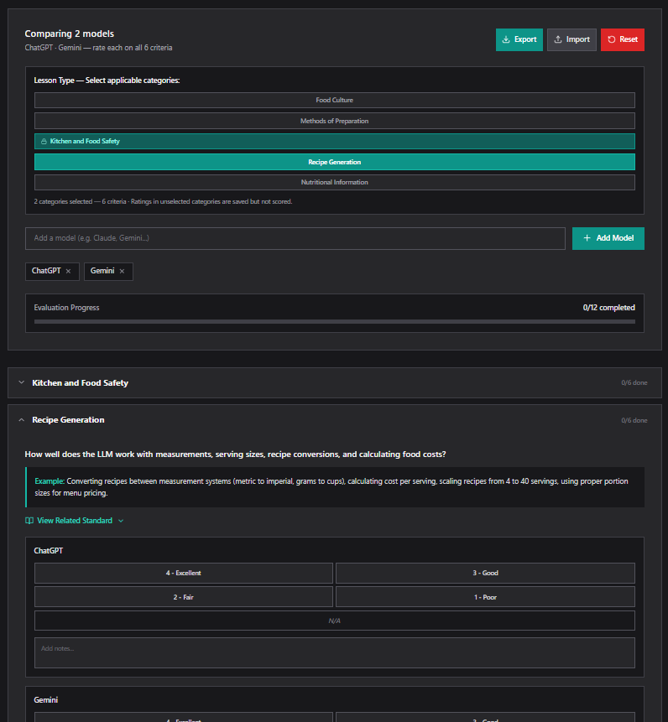
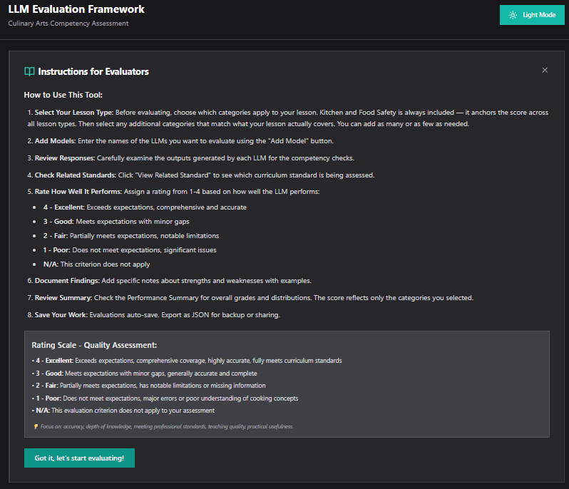
Version 3
Dark Mode
Selectable Lesson Focus
Adaptive Criteria Rating & Progress
Accessibility Audit
Notes:
Our first round of test users were mostly people we had access to who we knew had some prior experience related to culinary arts, whether personal or professional. Most of our initial user testers were current students (11) or working (5) and most users did not have teaching experience (13).

Slide 18
Product Demonstration

Slide 19
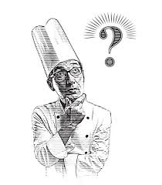
AI Lesson Planning: Which Model Do You Trust
Context:
You are going to use LLMs to create culinary lesson plans
Problem:
Are LLM-generated lesson plans trustworthy?
Which is the best LLM for my classroom needs?
Solution:
Objectively evaluate LLM with our Scorecard!

Slide 20
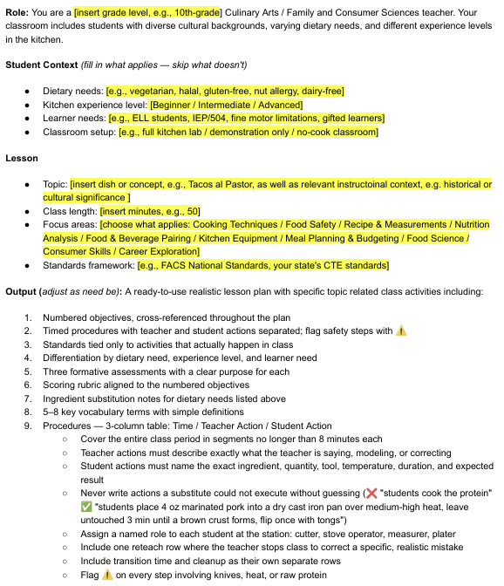
Customizing Prompts for Your Classroom
You will customize
Student Context (fill in what applies — skip what doesn't)
Dietary needs
[e.g., vegetarian, halal, gluten-free, nut allergy, dairy-free]
Kitchen experience level
Learner needs
Classroom setup
Lesson
Topic
Class length
Focus areas
Standards framework

Slide 21
QR code to score card
https://claude.ai/public/artifacts/a57bf522-83af-4954-8c4a-a9355d38b61d

Slide 22
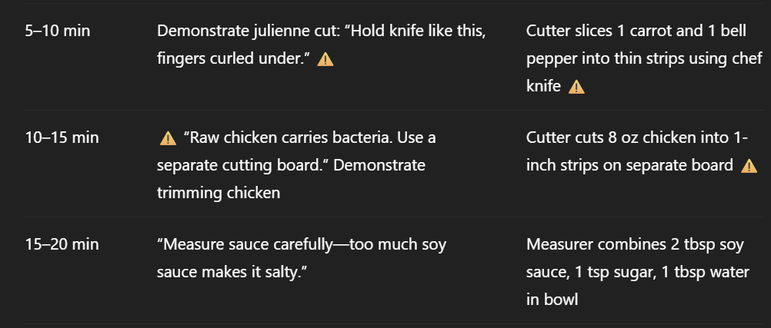
LLM generated Lesson Plan
Let's evaluate!!

Slide 23
03
Process

Slide 24
Vibe Coding Check
Based on Hardman’s 10 steps
Argues most L&D professionals rely on "vibes-based evaluation“
  Skimming AI output and approving without structured criteria
We replaced vibes with a cycle: define → generate output → score pass/fail → diagnose failure → fix the prompt → repeat
Our user testing served as the scoring phase
  Failures in the same areas Hardman said: objectives not tied to activities, standards listed without evidence, student actions too vague to execute
Diagnosed these as specification failures
  the prompt wasn't telling the AI what "good" looked like

Slide 25
Vibe Coding Check on Iterations
Based on Hardman’s 10 steps
Iteration 1
  Broad prompt, user testing revealed outputs were generic, objectives were untraceable, and 1 in 4 lesson plans failed the objectives-activity alignment check entirely
Iteration 2
  Tightened specification: added structured context, required 3-column procedures, named observable behavior, and had standards to named procedure steps
  ChatGPT and Gemini still produced vague student actions and long, overwhelming lesson plans
Iteration 3
  Closed generalization gap by making procedure timing realistic off actual lesson plans, requiring exact information in every student action, and making “output” more brief
  Validated across multiple LLMs to make sure all generated lesson plans met structure

Slide 26
04
Q&A?

Slide 27
THANK YOU
Please keep this slide for attribution

