Slide 1

EDUC789 - Seminar II
Spring 2026 - Dr. Todd Cherner
MCF Project
Social Studies
Evaluating LLM-Generated Lesson Plans with a Structured Scorecard
Presented By:
Milena Páez
Nashrah Alam
Erica Shao
Lauren Jones

Slide 2







Meet Our Group!
Milena Páez
Erica Shao
Nashrah Alam
Lauren Jones
Notes:
"we'll go down the line from left to right"
each person says own name:
*Hi, I'm _____*

Slide 3
Our Journey
Feedback
Charlotte
User Testing
2
Criteria
Alignment
User Testing
1
Scorecard
v3
Scorecard
Final
Scorecard
v1
Scorecard
v2

Slide 4
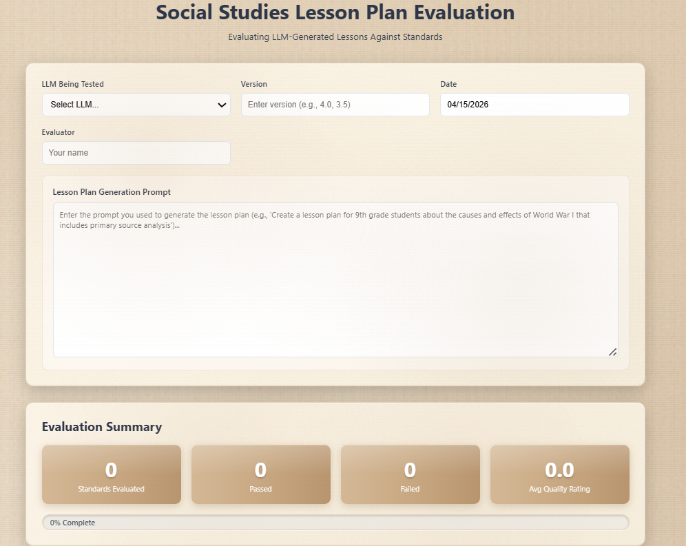
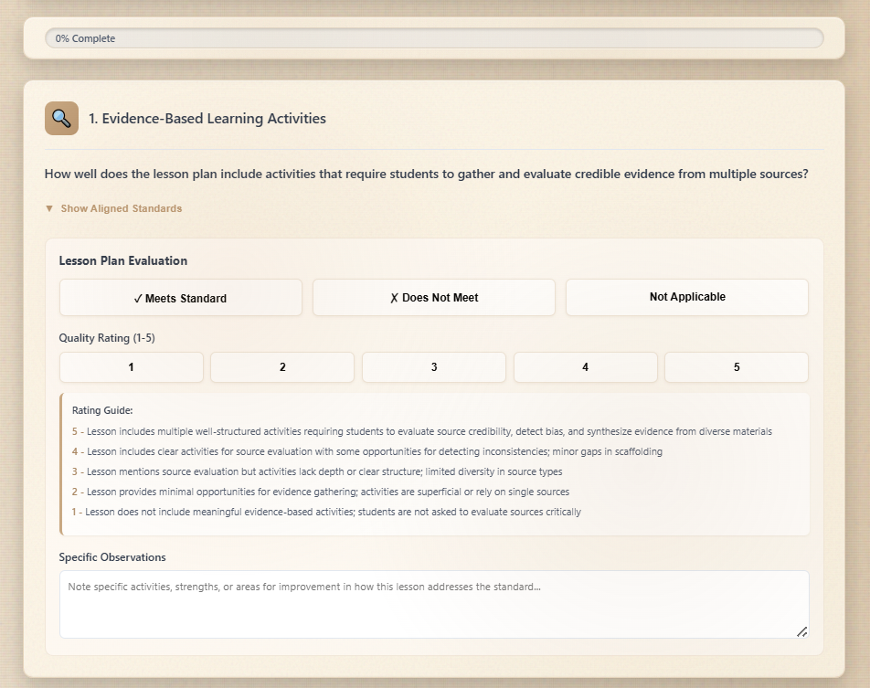
Scorecard: v1
Standards
1. Evidence-Based Learning Activities
2. Critical Thinking and Argumentation
3. Historical Cause and Effect Analysis
4. Timeline and Geographic Visualization
5. Comparative Systems Evaluation
Notes:
Strengths:
TASK ORIENTATION
*follow along with me from top to bottom
Starting with
1) task description: "Evaluating LLM-Generated Lesson Against Standards"
Significance = orients task for user
- saves onboarding time (task explanation through explicit framing)
2)
- Capped options: User selects LLM from capped number of selections (specified dropdown options)
3) asked to specify version (open-ended entry due to incredible variance)
4) Collected user-specific prompt to situate findings (greater intel to infuse pattern evaluation)
DURING EVALUATION
- “Not Applicable” Option
Areas for Improvement:

Slide 5
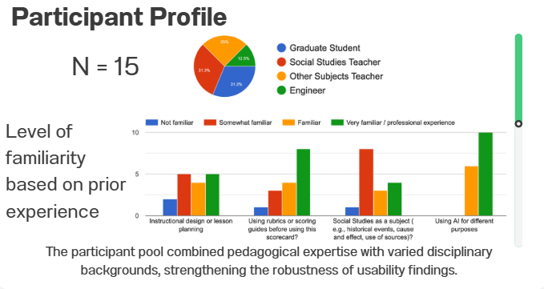
User Testing: Round 1
Feedback
Strengths
  High Overall Usability of the Scorecard
The interface structure and workflow were
intuitive for evaluators across diverse roles.
  Mean = 4.47 / 5
  93% (14/15) rated the tool 4 or 5
  Strong Perceived Appropriateness of the Evaluation Standards
  Mean = 4.33 / 5
  80% (12/15) rated 4 or 5

Slide 6
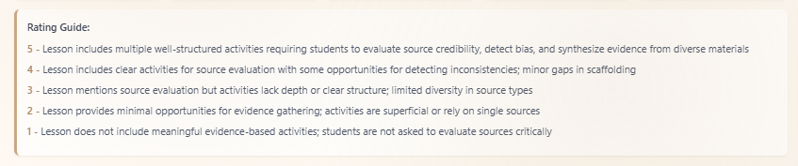
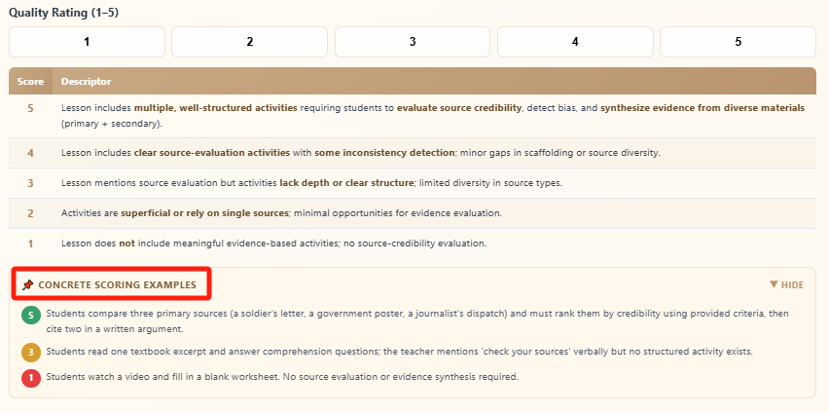

Scorecard: v2
Iterations based on Feedback
  Clarify overlapping criteria by bolding key differentiators
V1
V2
  Add specific examples
Notes:
Explain how the feedback from User Testing Round 1 helped to evolve the scorecard from v1 to v2

Slide 7
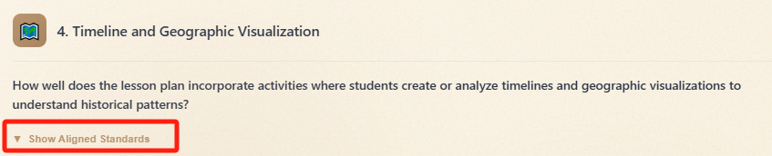
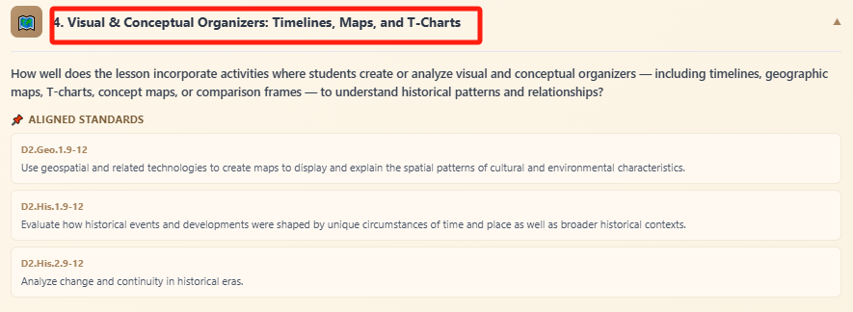
Scorecard: v2
Iterations based on Feedback
V1
  Revise the “Visualization” standard
V2
  Make aligned standards visible rather than hidden
Notes:
Explain how the feedback from User Testing Round 1 helped to evolve the scorecard from v1 to v2

Slide 8

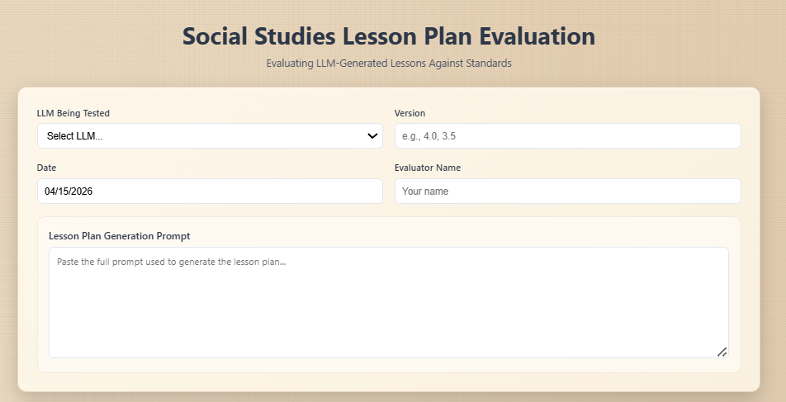
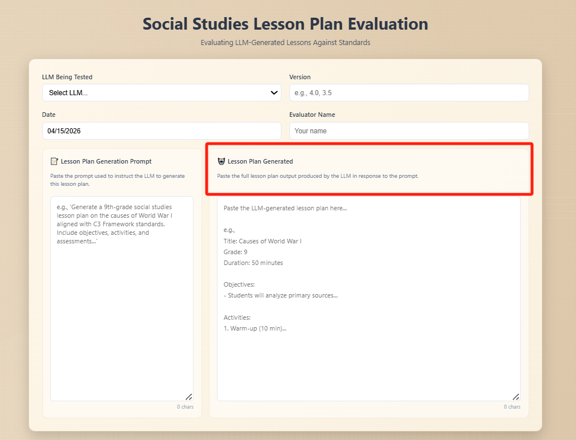
Charlotte’s Feedback
V3
V2
Notes:
Charlotte's Feedback = "have the ai tool input embedded into card"
instead opted

Slide 9
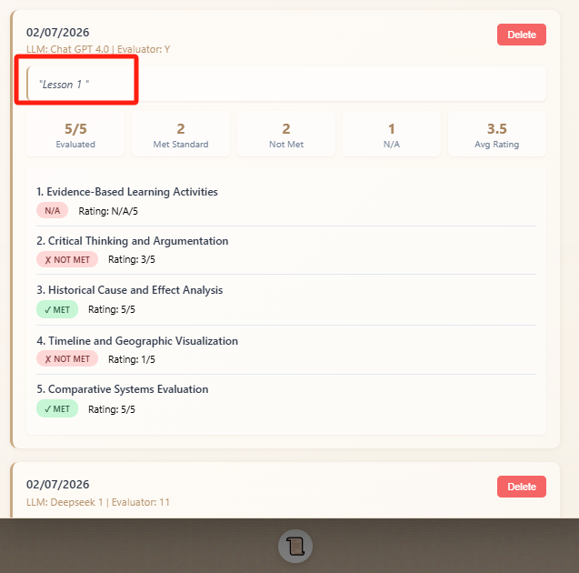
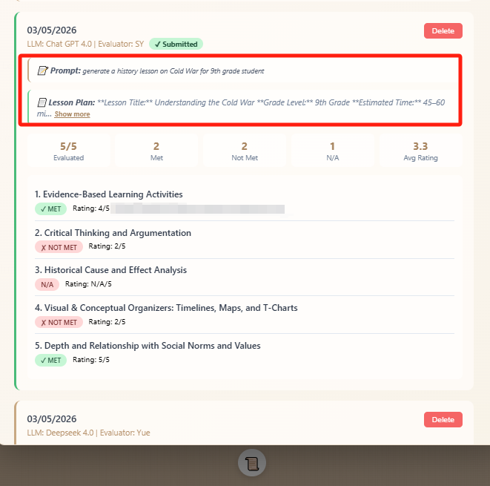
Charlotte’s Feedback
Notes:
Charlotte's Feedback = "have the ai tool input embedded into card"
instead opted

Slide 10


User Testing: Round 2
User Test Participants
Feedback
Total = 15
= Teacher
  Added a dedicated input field for the generated lesson plan, making evaluation more structured and transparent
  Made aligned standards directly visible, so evaluators can reference standards more easily while scoring
  Added detailed 1 to 5 score descriptors with bolded keywords to support clearer, more consistent evaluation
  Improved workflow with a direct “Submit Evaluation” button and a cleaner evaluation history layout
4 Social Studies
4 English
4 Math
2 Pre-Service
1 Engineer
Notes:
Who provided feedback and what was their feedback?
For Round 2, we tested the revised scorecard with 15 users from different backgrounds, including social studies, English, math, pre-service teachers, and one engineer.
The feedback was very positive overall, so at this stage we made smaller refinements to make the scorecard feel more cohesive and give it a more holistic, polished look

Slide 11
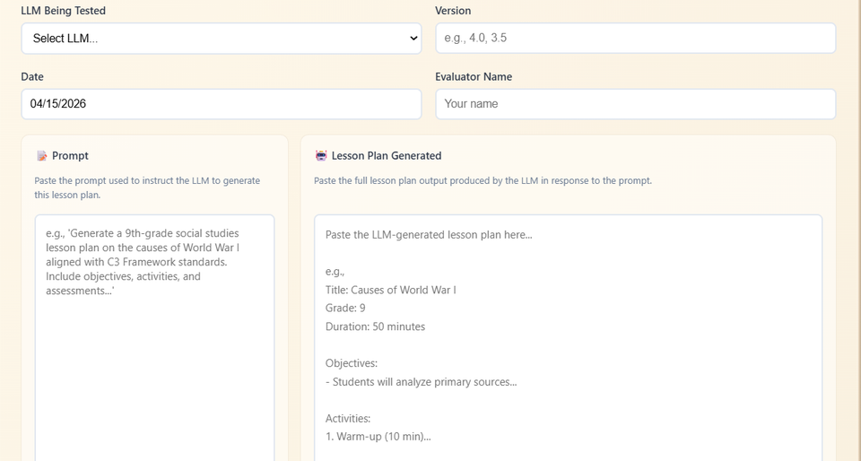
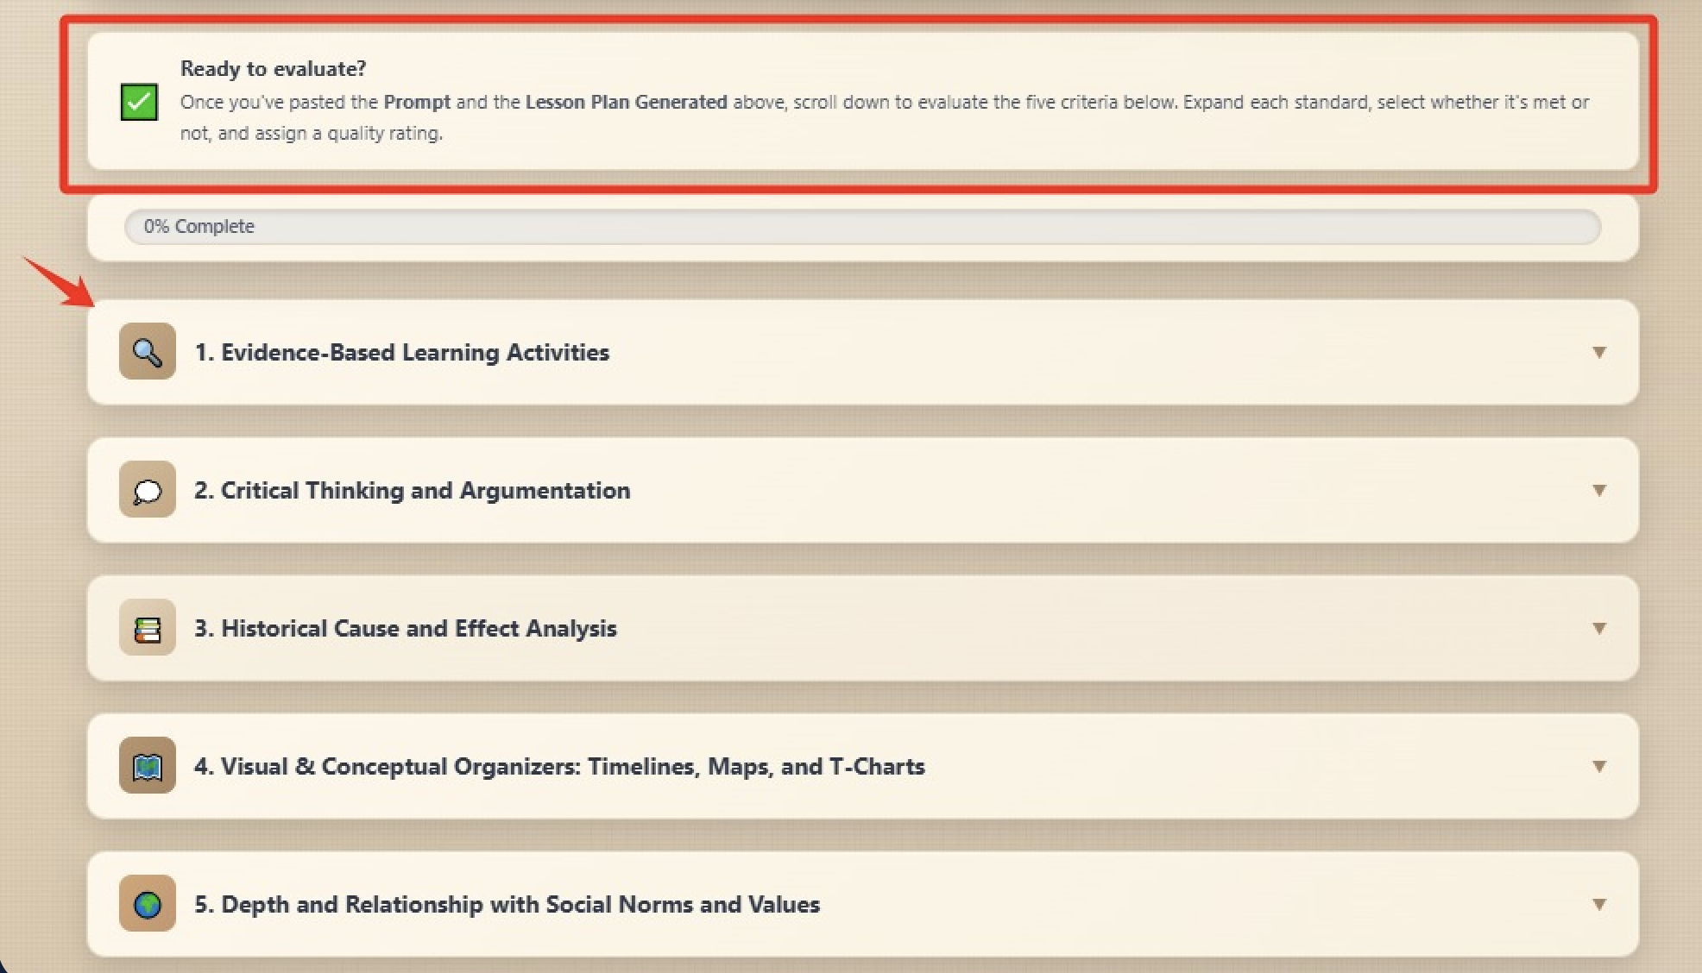
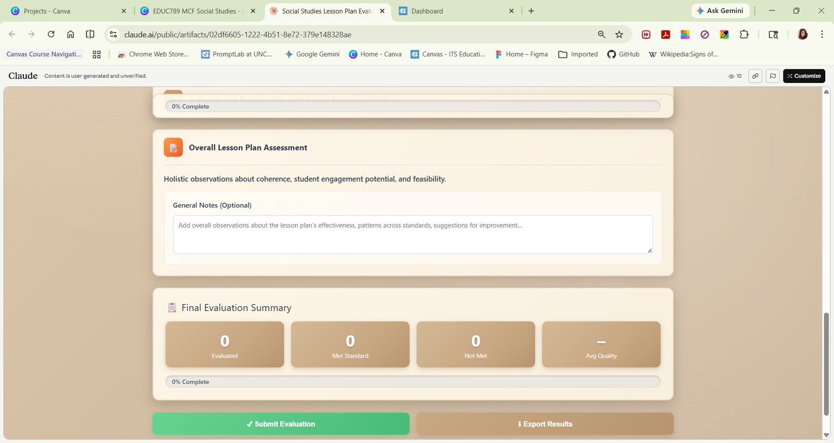
Scorecard: v3
Notes:
Explain how the feedback from User Testing Round 1 helped to evolve the scorecard from v2 to v3
We used the feedback from Round 1 to make the scorecard more clear, visible, and easier to use. In v3, we added dedicated spaces for the lesson prompt and generated lesson plan, made aligned standards directly visible, and improved the scoring section with clearer descriptors and examples. So the main change from v2 to v3 was moving from a tool that worked well to a tool that was much easier to understand and use consistently.

Slide 12

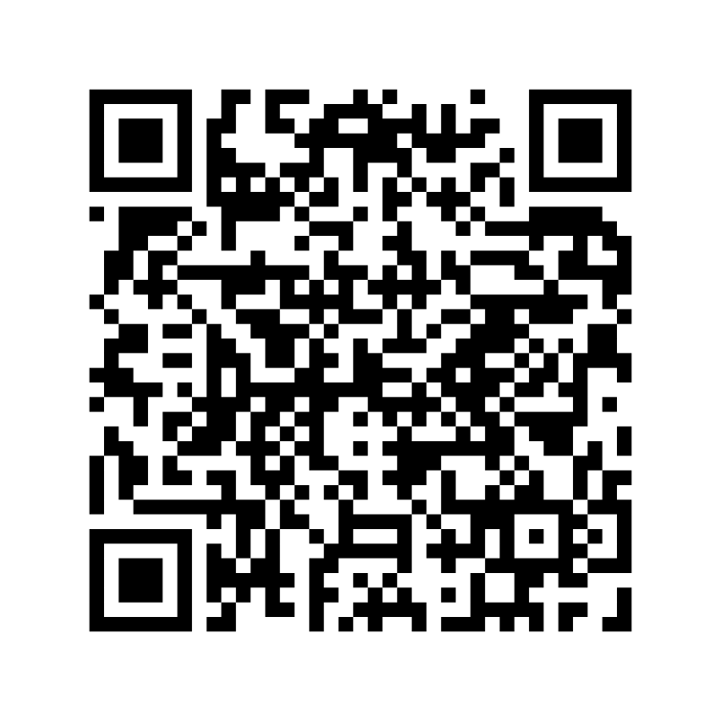
Access to our Final Scorecard Here

Slide 13

Vibe-Coding Check
From Vibe Coding to Structured AI Evaluation
Selected Component: Learning objectives as evaluation focus
Sample Generation: 3 lesson plans using initial prompt
Defined Criteria: 3–5 yes/no checks for objectives
Output Evaluation: Scored each lesson plan
Identified Patterns: Strengths and inconsistencies across plans
Prompt Refinement: Adjusted to align with criteria
Re-tested & Iterated: New outputs evaluated for improvement

Slide 14


Slide 15
Vibe-Coding Check
Selected Component:
Learning objectives as evaluation focus
Lesson 1
Lesson 2
Lesson 3
Sample Generation
Does the objective state what students will do using a measurable verb?
Yes
No
Yes
Defined Criteria
Output Evaluation
Are the objectives ordered according to Bloom’s Taxonomy?
No
No
No
Identified Patterns
Prompt Refinement
Does the objective specify the knowledge and/or skills to be developed?
No
Yes
Yes
Re-tested & Iterated

Slide 16
Our Prompt Iteration
Context & Audience
  High school Social Studies (Grade 11)
  Diverse learners, including ELL students
Output Structure
  Student-friendly lesson format
  Clear learning objectives
  Step-by-step instructions
  Guiding questions
Learning Goals
  Critical thinking
  Historical reasoning
  Civic understanding
Assessment & Support
  Final argument task (written or multimedia)
  Scaffolds for diverse learners
Core Cognitive Tasks
  Analyze multiple perspectives
  Evaluate evidence credibility
  Explain causes and effects
  Analyze systems (political, economic, social)
  Construct evidence-based arguments

Slide 17
Our Prompt Iteration
Context & Audience
  High school Social Studies (Grade 11)
  Diverse learners, including ELL students
Output Structure
  Student-friendly lesson format
  Clear learning objectives
  Step-by-step instructions
  Guiding questions
Learning Goals
  Critical thinking
  Historical reasoning
  Civic understanding
Assessment & Support
  Final argument task (written or multimedia)
  Scaffolds for diverse learners
Core Cognitive Tasks
  Recall key information about the event
  Explain causes and effects of the event
  Analyze multiple perspectives and systems
  Evaluate the credibility of evidence
  Construct an evidence-based argument for a specific audience

Slide 18
Our Prompt Iteration
Context & Audience
  High school Social Studies (Grade 11)
  Diverse learners, including ELL students
Output Structure
  Student-friendly lesson format
  Clear learning objectives
  Step-by-step instructions
  Guiding questions
Learning Goals
  Critical thinking
  Historical reasoning
  Civic understanding
Assessment & Support
  Explicitly require measurable action verbs in all learning objectives
  Require a clear progression across Bloom’s Taxonomy in the sequence of objectives
  Specify that each objective must include a distinct skill or knowledge outcome
  Ensure direct alignment between objectives and the final task
Core Cognitive Tasks
  Recall key information about the event
  Explain causes and effects of the event
  Analyze multiple perspectives and systems
  Evaluate the credibility of evidence
  Construct an evidence-based argument for a specific audience

Slide 19
EDUC789 - Seminar II
Spring 2026 - Dr. Todd Cherner
MCF Project
Social Studies
Thank You!
Q&A
Presented By:
Milena Páez
Nashrah Alam
Erica Shao
Lauren Jones

